Slide 1
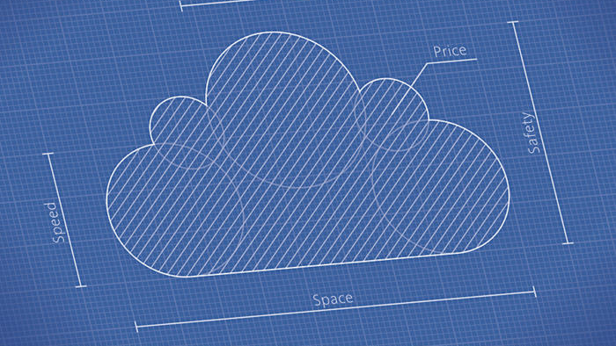
Elastic Runtime Architecture

Slide 2

PCF is now umbrella (From 2018)
Pivotal Cloud Foundry
Pivotal Application Services (Previously PCF)
Pivotal Container Service
Pivotal Function Service

Slide 3
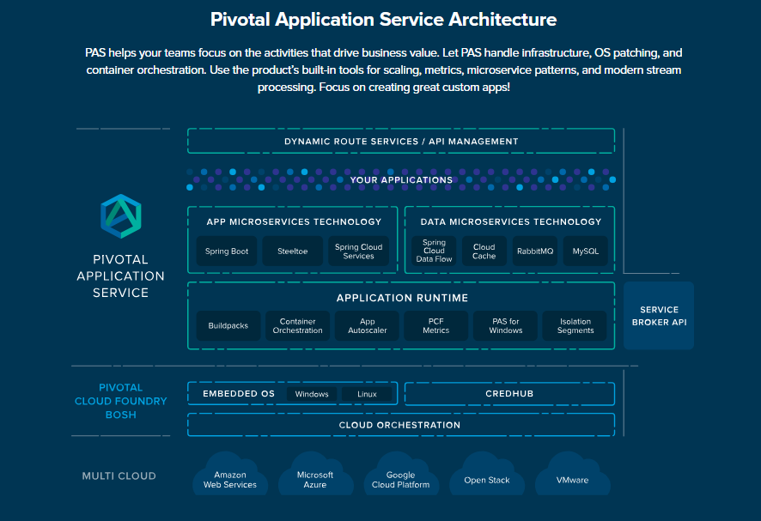

Slide 4
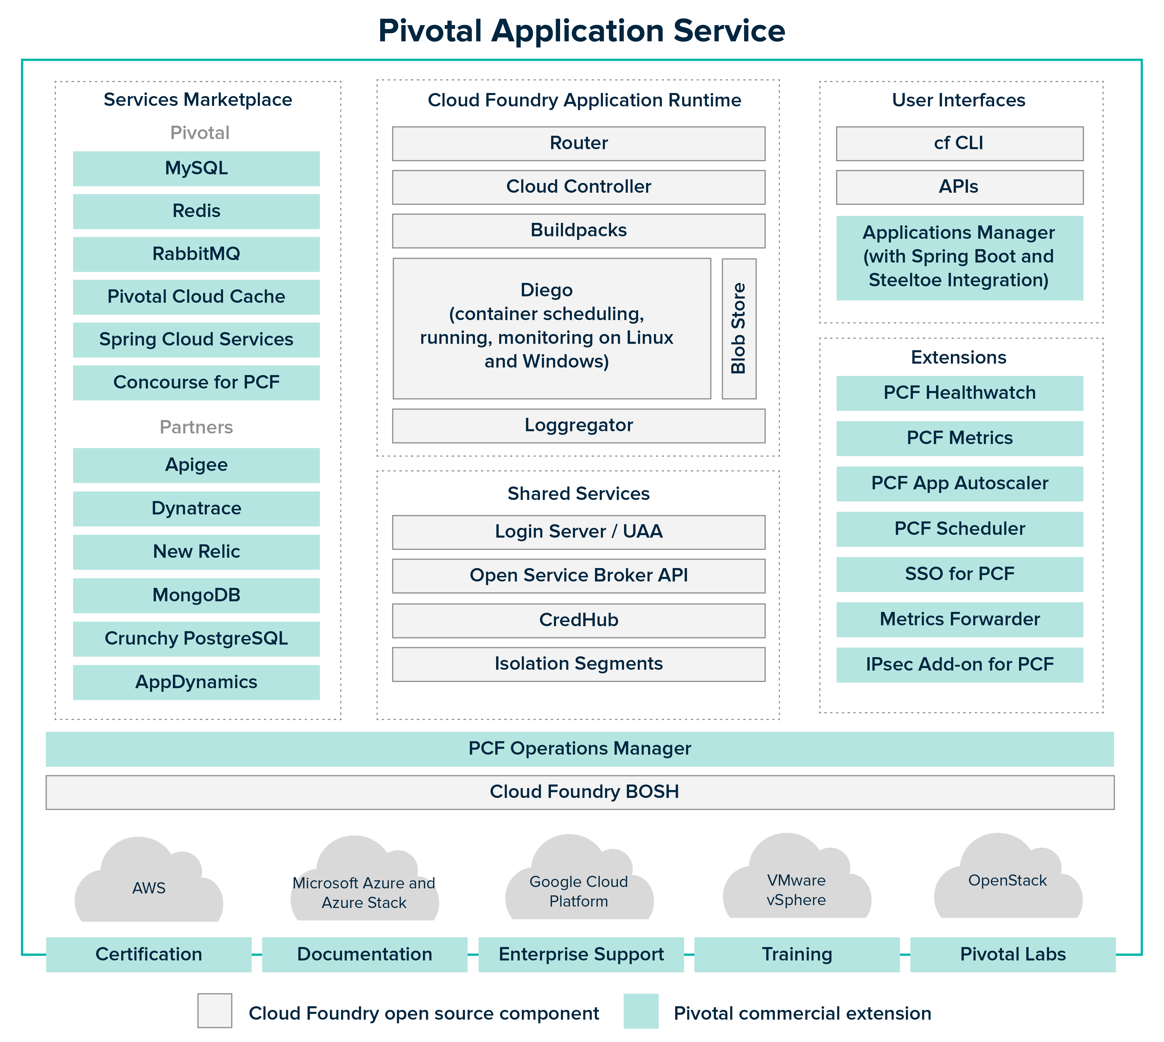

Slide 5
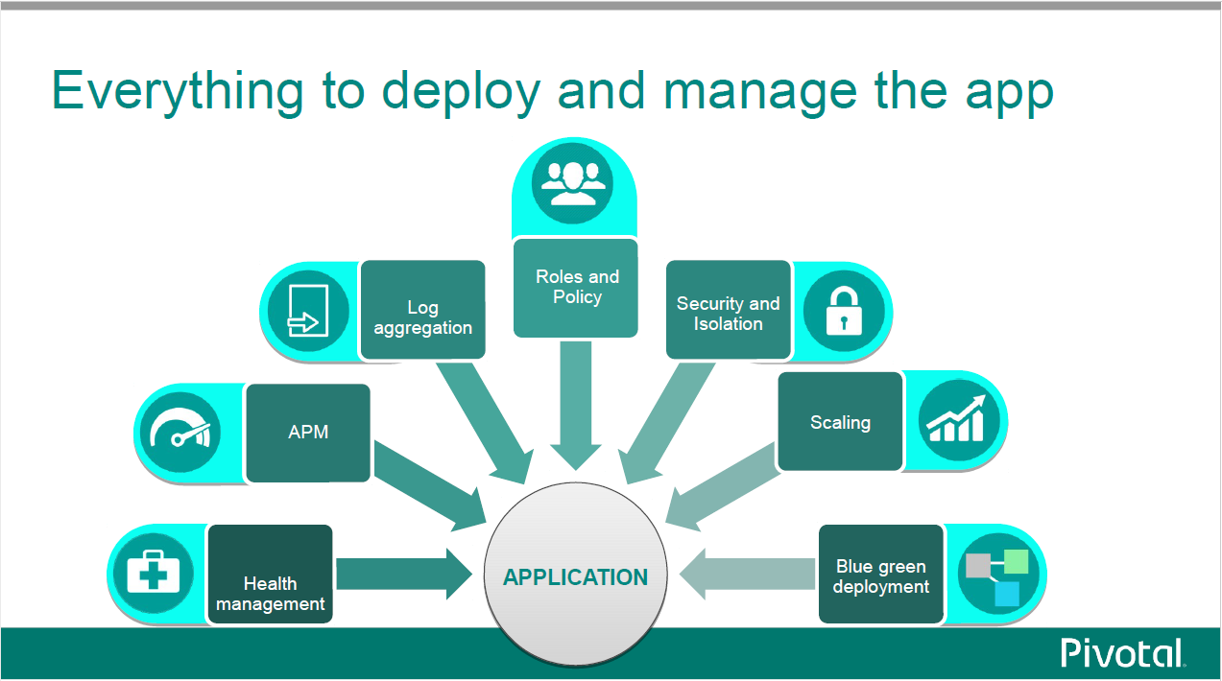

Slide 6

BOSH
BOSH is a deployment manager that can automatically provision and deploy widely distributed, cloud-based software.
Essentially, BOSH is what allows PCF to be deployed in any cloud by providing an interface to build required infrastructure components on top of a given IaaS platform.
BOSH handles the deployment of the underlying PCF infrastructure by launching and managing all required component VMs.
Through common plugins such as the Health Monitor, BOSH can track the health of its VMs and also self-heal if it detects that a VM has crashed or has otherwise become inaccessible. It will attempt to recreate the faulty VM automatically to avoid downtime.

Slide 7

Router
The Gorouter is PCF’s router (written in Go).
It handles and routes incoming requests. These requests come either from operators or developers sending commands—such as cf push—that are then routed to the Cloud Controller API, or from end users accessing application instances running on the deployment.
The Gorouter communicates with the Diego BBS to keep track of which applications exist, how many instances there are, and where they are running in order to maintain a routing table and shuttle user traffic appropriately.
It provides basic round-robin load balancing for sending traffic to available application instances.

Slide 8

Cloud Controller
Pivotal Cloud Foundry’s Cloud Controller (CC) provides API endpoints for operators and developers to interact with PCF and the applications running on a specific domain.
The Cloud Controller (CC) directs the deployment of applications. To push an app to Cloud Foundry, you target the Cloud Controller.
Commands include staging applications, starting or stopping applications, collecting health information, and querying that all desired applications are running.
The Cloud Controller also maintain records of orgs, spaces, user roles, services, and more.
The CC is also responsible for communicating with the User Account and Authentication server to authenticate the user and ensure that they have the proper permissions to perform the requested task.

Slide 9

Tasks and LRP
LRP :
LRPs are one or more application instances or other processes that are generally continuous, scalable, and always available.
PCF attempts to ensure high availability and resilience by maintaining multiple running instances of the same LRP across availability zones.
Diego and the Cloud Controller work together to ensure that the number of running LRPs (ActualLRPs) matches the number that the system should be running (DesiredLRPs).
Task :
Tasks are one-off processes—that is, tasks are inherently terminating and provide a success/failure response. A task could be a database migration, or an initial service setup.
Containers running tasks are destroyed once the task is complete.

Slide 10

Diego (Previously DEA)
Diego is the container orchestration system for Cloud Foundry deployments.
Diego handles the creation and management of the containers that stage and run applications.
PCF operators can use the Ops Manager to choose which runtime backend they want to use—the Guardian backend for Linux or Garden Windows for Windows (or both).
To accomplish its orchestration tasks, Diego relies on three main components:
the Diego Brain
The BBS
one or more Diego cells

Slide 11

Diego Brain
The main purpose of the Diego Brain is to schedule and assign incoming requests to the cells for execution.
The primary component responsible for this is the Auctioneer. The Auctioneer receives work from the Cloud Controller via the BBS.
It then communicates with a cell via the cell’s Rep (the point of contact between the cell and the rest of the deployment) to auction off this work after the Stager translates it into Tasks and LRPs.
Its auction algorithm operates with the following descending priorities: ensure that all LRPs have at least one instance running at all times; assign all tasks/LRPs in the current batch; distribute process load across running instances and availability zones to ensure availability.
The Diego Brain’s other components carry out additional functions, including maintaining correct LRP counts, storing and handling resources required for application staging, or providing SSH access to application containers.

Slide 12
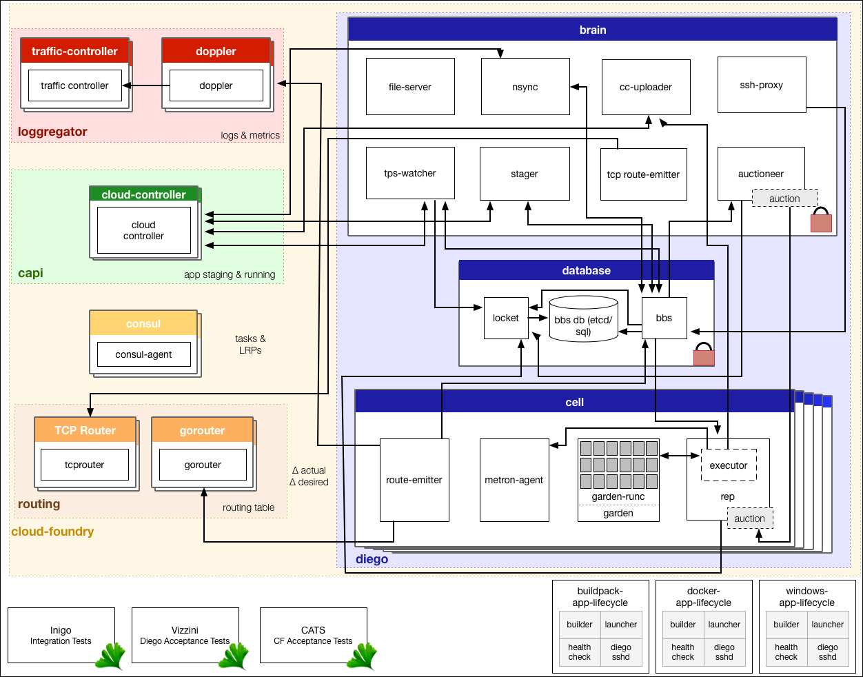

Slide 13
BBS (Bulletin Board System)
The BBS is the intermediary between the CC and the Auctioneer and provides an API to communicate with and send requests to the Diego cells.
It is the gateway through which information about DesiredLRPs and ActualLRPs flows and is vital to maintaining an accurate picture of the Diego cluster.
The BBS requires its own relational database (MySQL or Postgres) to maintain a record of cell status, unallocated work, and other information.
It uses this database to keep an up-to-date image of all the work the Diego cluster is handling and sends that to the Auctioneer when it is assigning a new batch so that work can be distributed appropriately.
The BBS also runs regular convergence assessments that compare the running state on the Diego cells against the desired state provided by the Cloud Controller to ensure they are the same.

Slide 14
Diego cells
Diego cells are host VMs that run the containers doing the actual work.
Multiple Diego cells can be running in the deployment using different stemcells and releases, or even Garden backends.
The Rep on each cell performs a number of functions: for starters, it registers and maintains the cell’s presence with the BBS, and it communicates with the Auctioneer to bid for auctioned jobs.
When a task or LRP is accepted, the Rep’s internal process, the Executor, instructs Garden to create a container to run it. The Rep also forwards information about completed tasks to the BBS.
The Rep also monitors resource allocation in comparison to the cell’s capacity. Finally, it forwards metrics and logs from the containers to the central Loggregator system.

Slide 15
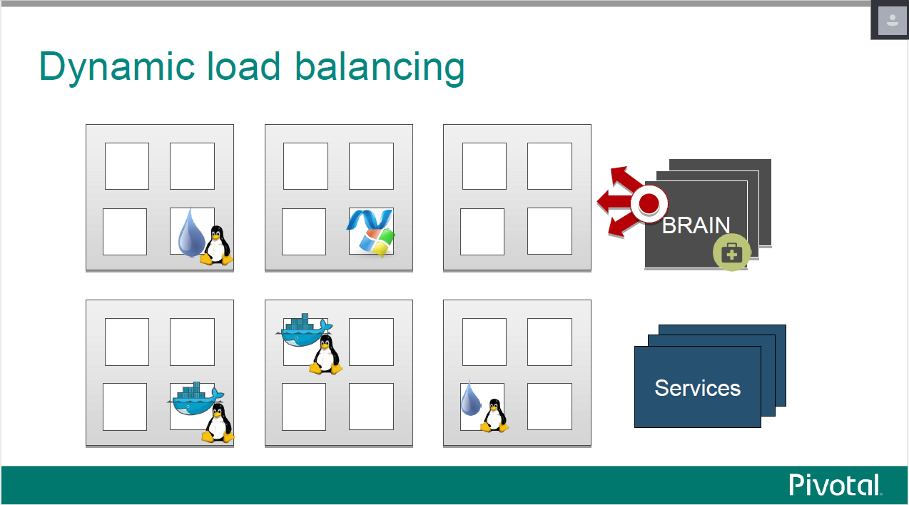

Slide 16
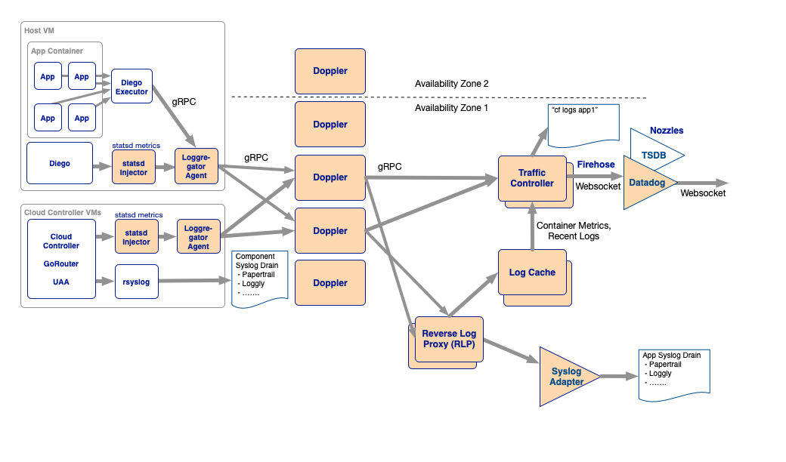
Loggregator

Slide 17
Loggregator
Loggregator is a system that aggregates and streams logs and (despite its name) metrics from PCF infrastructure components as well as instrumented applications running on the deployment.
Loggregator collects platform metrics from PCF components, system-level resource metrics from the VMs, and application logs.
Loggregator will also collect available metrics from installed services. That is, some PCF add-on products (for example, Redis) publish their own metrics, which are then forwarded to Loggregator and included in a data stream called the Firehose.
Application logs include any logs that an application writes to stderr or stdout.
These translated logs and metrics are then sent to processes that run on the VMs called Metron Agents, which forward them using gRPC to Doppler servers.

Slide 18
Dopplers hold messages temporarily before sending them on to one of two destinations. By default, they go to a Traffic Controller, which aggregates everything from all availability zones before shuttling it on in a stream that is accessible either via the CF logging API (accessed by cf logs) or via the Firehose.
Syslog Adapter that transforms the messages into standard syslog format. They then can be accessed by one or more third-party syslog drains that users can bind to an application.
By default, Dopplers are unable to store logs.* If logs coming from a specific buffer cannot be consumed as quickly as they are being produced or forwarded, information will simply be wiped to make room for the next batch of logs. This means that scaling each component properly is important. Having an appropriate number of Metrons, Dopplers, and Traffic Controllers will help ensure no logs are dropped on the floor.
By Default, Doppler accepts 2000 events per second.

Slide 19

Diego Auction
The Cloud Controller passes requests to stage and run apps to several components on the Diego Brain.
The Diego Brain components translate staging and running requests into Tasks and Long Running Processes (LRPs), then submit these to the Bulletin Board System (BBS) through an API over HTTP.
The BBS submits the Tasks and LRPs to the Auctioneer, part of the Diego Brain.
The Auctioneer distributes these Tasks and LRPs to Cells through an Auction. The Diego Brain communicates with Diego Cells using SSL/TLS protocol.
Once the Auctioneer assigns a Task or LRP to a Cell, an in-process Executor creates a Garden container in the Cell. The Task or LRP runs in the container.
The BBS tracks desired LRPs, running LRP instances, and in-flight Tasks. It also periodically analyzes this information and corrects discrepancies to ensure consistency between ActualLRP and DesiredLRP counts.

Slide 20
